Slide 1
Normalization Rule in SQL Dr B Codd of IBM
1NF,2NF,3NF,BCNF,4NF

Slide 2
Problems Without Normalization
If a table is not properly normalized and have data redundancy then it will not only eat up extra memory space but will also make it difficult to handle and update the database, without facing data loss. Insertion, Updation and Deletion Anomalies are very frequent if database is not normalized. To understand these anomalies let us take an example of a Student table.
rollno | name | branch | hod | office_tel
401 | Akon | CSE | Mr. X | 53337
402 | Bkon | CSE | Mr. X | 53337
403 | Ckon | CSE | Mr. X | 53337
404 | Dkon | CSE | Mr. X | 53337
In the table above, we have data of 4 Computer Sci. students. As we can see, data for the fields branch, hod(Head of Department) and office_tel is repeated for the students who are in the same branch in the college, this is Data Redundancy.

Slide 3
Insertion Anomaly Suppose for a new admission, until and unless a student opts for a branch, data of the student cannot be inserted, or else we will have to set the branch information as NULL.
Also, if we have to insert data of 100 students of same branch, then the branch information will be repeated for all those 100 students.
These scenarios are nothing but Insertion anomalies.
Updation Anomaly
What if Mr. X leaves the college? or is no longer the HOD of computer science department? In that case all the student records will have to be updated, and if by mistake we miss any record, it will lead to data inconsistency. This is Updation anomaly.
Deletion Anomaly
In our Student table, two different informations are kept together, Student information and Branch information. Hence, at the end of the academic year, if student records are deleted, we will also lose the branch information. This is Deletion anomaly.

Slide 4
Normalization Rule
Normalization rules are divided into the following normal forms:
First Normal Form
Second Normal Form
Third Normal Form
BCNF
Fourth Normal Form

Slide 5
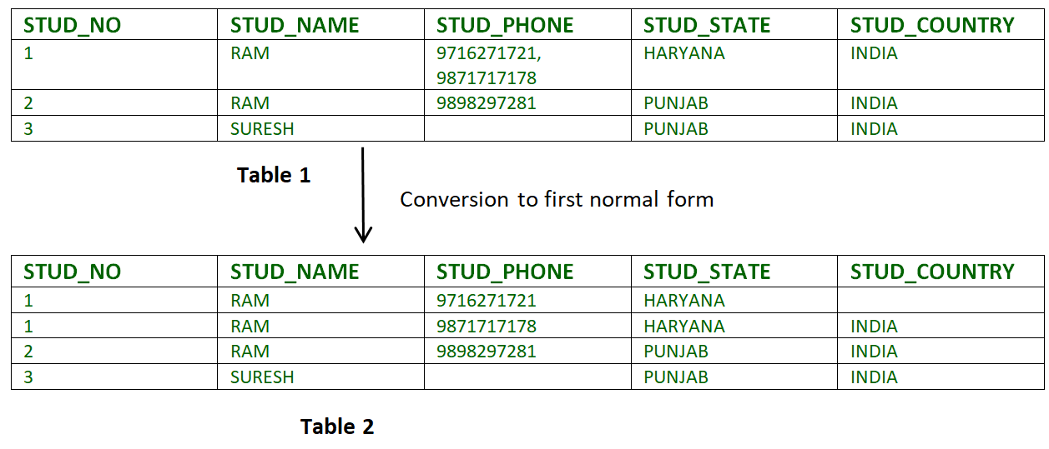
First Normal Form (1NF)
For a table to be in the First Normal Form, it should follow the following 4 rules:
It should only have single(atomic) valued attributes/columns.
Values stored in a column should be of the same domain
All the columns in a table should have unique names.
And the order in which data is stored, does not matter.
Example-1: Relation STUDENT in table 1 is not in 1NF because of multi-valued attribute STUD_PHONE. Its decomposition into 1NF has been shown in table 2.

Slide 6
Second Normal Form (2NF)
For a table to be in the Second Normal Form,
It should be in the First Normal form.
In the second normal form, all non-key attributes are fully functional dependent on the primary key
What is Dependency?
Let's take an example of a Student table with columns student_id, name, reg_no(registration number), branch and address(student's home address).
student_id | name | reg_no | branch | address
In this table, student_id is the primary key and will be unique for every row, hence we can use student_id to fetch any row of data from this table
Even for a case, where student names are same, if we know the student_id we can easily fetch the correct record.
student_id | name | reg_no | branch | address
10 | Akon | 07-WY | CSE | Kerala
11 | Akon | 08-WY | IT | Gujarat
Hence we can say a Primary Key for a table is the column or a group of columns(composite key) which can uniquely identify each record in the table.
So all I need is student_id and every other column depends on it, or can be fetched using it.
This is Dependency and we also call it Functional Dependency.

Slide 7
What is Partial Dependency?
Subject Table
For a simple table like Student, a single column like student_id can uniquely identfy all the records in a table.
But this is not true all the time. So now let's extend our example to see if more than 1 column together can act as a primary key.
Let's create another table for Subject, which will have subject_id and subject_name fields and subject_id will be the primary key.
subject_id | subject_name
1 | Java
2 | C++
3 | Php
Score Table
Now we have a Student table with student information and another table Subject for storing subject information.
Let's create another table Score, to store the marks obtained by students in the respective subjects. We will also be saving name of the teacher who teaches that subject along with marks.
score_id | student_id | subject_id | marks | teacher
1 | 10 | 1 | 70 | Java Teacher
2 | 10 | 2 | 75 | C++ Teacher
3 | 11 | 1 | 80 | Java Teacher
if I ask you to get me marks of student with student_id 10, can you get it from this table? No, because you don't know for which subject. And if I give you subject_id, you would not know for which student. Hence we need student_id + subject_id to uniquely identify any row.
So This can be considered as Primary Key
Student Table
student_id | name | reg_no | branch | address
10 | Akon | 07-WY | CSE | Kerala
11 | Akon | 08-WY | IT | Gujarat

Slide 8
But where is Partial Dependency?
Now if you look at the Score table, we have a column names teacher which is only dependent on the subject, for Java it's Java Teacher and for C++ it's C++ Teacher & so on.
Now as we just discussed that the primary key for this table is a composition of two columns which is student_id & subject_id but the teacher's name only depends on subject, hence the subject_id, and has nothing to do with student_id.
This is Partial Dependency, where an attribute in a table depends on only a part of the primary key and not on the whole key.
score_id | student_id | subject_id | marks | teacher
1 | 10 | 1 | 70 | Java Teacher
2 | 10 | 2 | 75 | C++ Teacher
3 | 11 | 1 | 80 | Java Teacher
How to remove Partial Dependency?
There can be many different solutions for this, but out objective is to remove teacher's name from Score table.
The simplest solution is to remove columns teacher from Score table and add it to the Subject table. Hence, the Subject table will become:
subject_id | subject_name | teacher
1 | Java | Java Teacher
2 | C++ | C++ Teacher
3 | Php | Php Teacher

Slide 9
And our Score table is now in the second normal form, with no partial dependency.
subject_id | subject_name | teacher
1 | Java | Java Teacher
2 | C++ | C++ Teacher
3 | Php | Php Teacher
score_id | student_id | subject_id | marks | teacher
1 | 10 | 1 | 70 | Java Teacher
2 | 10 | 2 | 75 | C++ Teacher
3 | 11 | 1 | 80 | Java Teacher
Quick Recap
For a table to be in the Second Normal form, it should be in the First Normal form and it should not have Partial Dependency.
Partial Dependency exists, when for a composite primary key, any attribute in the table depends only on a part of the primary key and not on the complete primary key.
To remove Partial dependency, we can divide the table, remove the attribute which is causing partial dependency, and move it to some other table where it fits in well.
score_id | student_id | subject_id | marks
1 | 10 | 1 | 70
2 | 10 | 2 | 75
3 | 11 | 1 | 80

Slide 10
Third Normal Form (3NF)
Requirements for Third Normal Form
For a table to be in the third normal form,
It should be in the Second Normal form.
And it should not have Transitive Dependency.
What is Transitive Dependency?
score_id | student_id | subject_id | marks | exam_name | total_marks
With exam_name and total_marks added to our Score table, it saves more data now. Primary key for our Score table is a composite key, which means it's made up of two attributes or columns → student_id + subject_id.
New column exam_name depends on both student and subject. For example, a mechanical engineering student will have Workshop exam but a computer science student won't. And for some subjects you have Practical exams and for some you don't. So we can say that exam_name is dependent on both student_id and subject_id.
That about our second new column total_marks? Does it depend on our Score table's primary key?
Well, the column total_marks depends on exam_name as with exam type the total score changes. For example, practicals are of less marks while theory exams are of more marks.
But, exam_name is just another column in the score table. It is not a primary key or even a part of the primary key, and total_marks depends on it.
This is Transitive Dependency. When a non-prime attribute depends on other non-prime attributes rather than depending upon the prime attributes or primary key.

Slide 11
How to remove Transitive Dependency?
Again the solution is very simple. Take out the columns exam_name and total_marks from Score table and put them in an Exam table and use the exam_id wherever required.
Score Table: In 3rd Normal Form
score_id | student_id | subject_id | marks | exam_name | total_marks
score_id | student_id | subject_id | marks | exam_id
The new Exam table
exam_id | exam_name | total_marks
1 | Workshop | 200
2 | Mains | 70
3 | Practicals | 30
Advantage of removing Transitive Dependency
The advantage of removing transitive dependency is,
Amount of data duplication is reduced.
Data integrity achieved.

Slide 12
Boyce-Codd Normal Form (BCNF)
Rules for BCNF
For a table to satisfy the Boyce-Codd Normal Form, it should satisfy the following two conditions:
It should be in the Third Normal Form.
And, for any dependency A → B, A should be a super key.
The second point sounds a bit tricky, right? In simple words, it means, that for a dependency A → B, A cannot be a non-prime attribute, if B is a prime attribute.
we have a college enrolment table with columns student_id, subject and professor.
student_id | subject | professor
101 | Java | P.Java1
101 | C++ | P.Cpp
102 | Java | P.Java2
103 | C# | P.Chash
104 | Java | P.Java
In the table above:
One student can enrol for multiple subjects. For example, student with student_id 101, has opted for subjects - Java & C++
For each subject, a professor is assigned to the student.
And, there can be multiple professors teaching one subject like we have for Java.

Slide 13
What do you think should be the Primary Key?
Well, in the table above student_id, subject together form the primary key, because using student_id and subject, we can find all the columns of the table.
One more important point to note here is, one professor teaches only one subject, but one subject may have two different professors.
Hence, there is a dependency between subject and professor here, where subject depends on the professor name.
This table satisfies the 1st Normal form because all the values are atomic, column names are unique and all the values stored in a particular column are of same domain.
This table also satisfies the 2nd Normal Form as their is no Partial Dependency.
And, there is no Transitive Dependency, hence the table also satisfies the 3rd Normal Form.
But this table is not in Boyce-Codd Normal Form.
student_id | subject | professor
101 | Java | P.Java
101 | C++ | P.Cpp
102 | Java | P.Java2
103 | C# | P.Chash
104 | Java | P.Java
Why this table is not in BCNF?
In the table above, student_id, subject form primary key, which means subject column is a prime attribute.
But, there is one more dependency, professor → subject.
And while subject is a prime attribute, professor is a non-prime attribute, which is not allowed by BCNF.

Slide 14
How to satisfy BCNF? Northwind
To make this relation(table) satisfy BCNF, we will decompose this table into two tables, student table and professor table.
Below we have the structure for both the tables.
student_id | subject | professor
101 | Java | P.Java
101 | C++ | P.Cpp
102 | Java | P.Java2
103 | C# | P.Chash
104 | Java | P.Java
Student Table
student_id | p_id
101 | 1
101 102 | 2 3
Professor Table
p_id | professor | subject
1 | P.Java | Java
2 3 | P.Cpp p.Java2 | C++ Java
And now, this relation satisfy Boyce-Codd Normal Form. In the next tutorial we will learn about the Fourth Normal Form.

Slide 15
Fourth Normal Form (4NF)
Rules for 4th Normal Form
For a table to satisfy the Fourth Normal Form, it should satisfy the following two conditions:
It should be in the Boyce-Codd Normal Form.
And, the table should not have any Multi-valued Dependency.
What is Multi-valued Dependency?
A table is said to have multi-valued dependency, if the following conditions are true,
For a dependency A → B, if for a single value of A, multiple value of B exists, then the table may have multi-valued dependency.
Also, a table should have at-least 3 columns for it to have a multi-valued dependency.
And, for a relation R(A,B,C), if there is a multi-valued dependency between, A and B, then B and C should be independent of each other.
If all these conditions are true for any relation(table), it is said to have multi-valued dependency
s_id | course | hobby
1 | Science | Cricket
1 | Maths | Hockey
2 | C# | Cricket
2 | Php | Hockey
And, in the table above, there is no relationship between the columns course and hobby. They are independent of each other.
So there is multi-value dependency, which leads to un-necessary repetition of data and other anomalies as well.

Slide 16
How to satisfy 4th Normal Form?
To make the above relation satify the 4th normal form, we can decompose the table into 2 tables.
CourseOpted Table
Hobbies Table
s_id | course
1 | Science
1 | Maths
2 | C#
2 | Php
s_id | hobby
1 | Cricket
1 | Hockey
2 | Cricket
2 | Hockey
Now this relation satisfies the fourth normal form.
A table can also have functional dependency along with multi-valued dependency. In that case, the functionally dependent columns are moved in a separate table and the multi-valued dependent columns are moved to separate tables.

